Slide 1
Day Planner
UML DIAGRAM

Slide 2
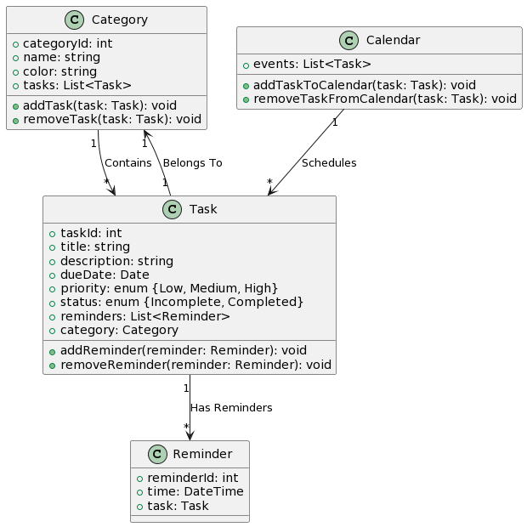
Class Diagram

Slide 3
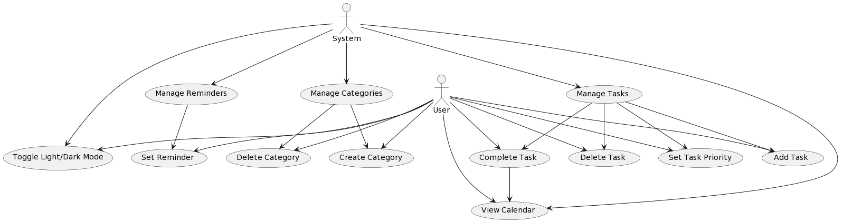
Use Case Diagram

Slide 4
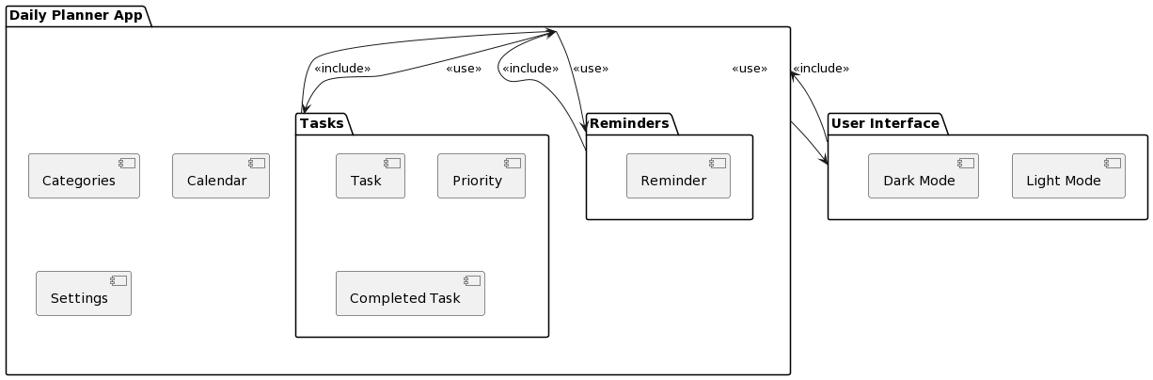
Package Diagram

Slide 5
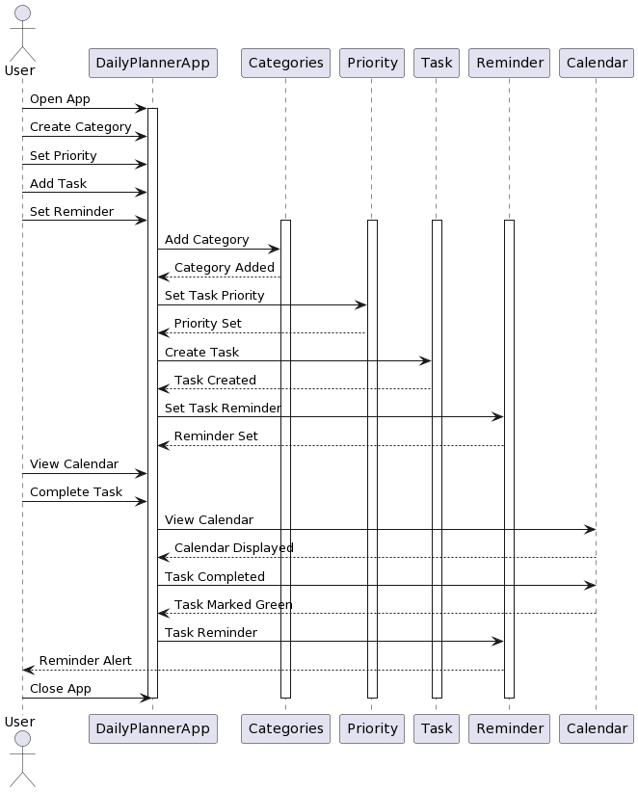
Sequence

Slide 6
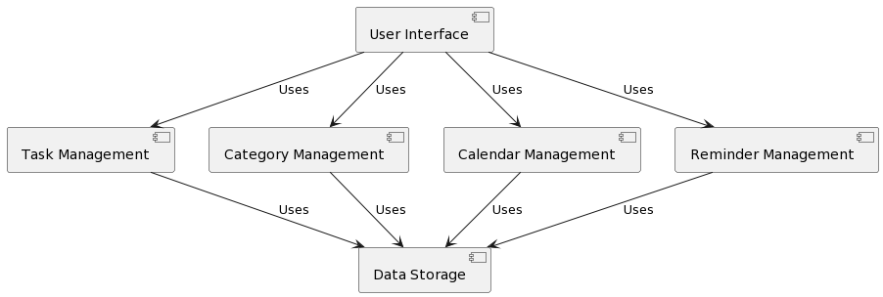
Components

Slide 7
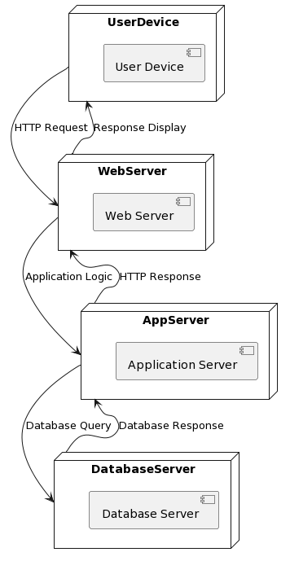
Deployment

Slide 8
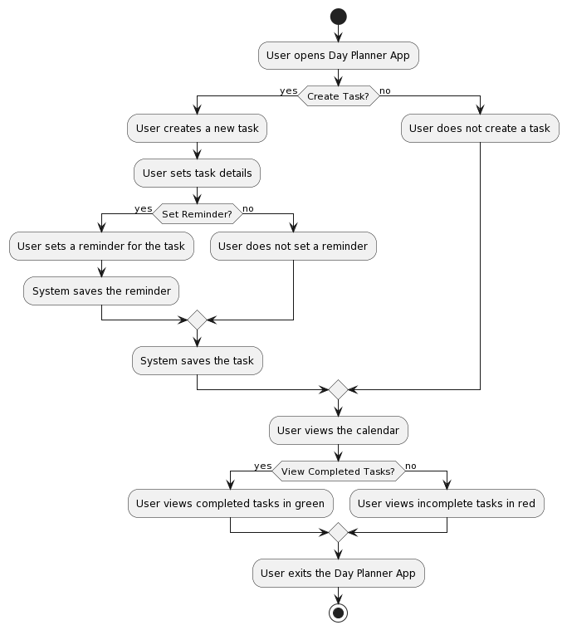
Activity Diagram

Slide 9
Collaboration Diagram

